Slide 1

LatentView Analytics
Data Driven Intelligence to Identify High Net Worth Customers
October 2020

Slide 2
Agenda
1
Business Objective
2
Solution Approach
2a
Analyse & Understand Behavioral Patterns of High Net Worth Customers
2b
Enhance Recommendations by Augmenting with External Data
2c
Evaluate Performance using A/B Testing
3
Representative Case Studies

Slide 3
Business Objective

Slide 4
Business Objective
Business Objective:
Leverage analytics to identify Customers within Harrods database for whom assisted shopping intervention would be a success and lead to higher overall revenue.
Hypothesis:
Customer data at Harrods can be mined to uncover patterns that signify wealth and propensity to higher spends. These patterns when uncovered can help identify the Customers who are of high value to Harrods.
This information can be further clubbed with other external and syndicated data to enhance model recommendations, thus providing avenues for hyper personalized experience to each of this individual Customer

Slide 5
Solution Approach

Slide 6










Data Mining Process Flow
The below illustration represents a typical Data mining Approach right from gathering Customer data to building model and fine tuning it based on performance
Customer Transactional Data
Exploratory Data Analysis
Clustering
Identifying Target Segments
Product Recommendation
Augment with External Data
Evaluate Model Performance
Refine Existing Models

Slide 7



Solution Approach
Latentview recommends a three-step approach to fulfill Harrod’s business objective
How to identify and engage High Net Worth Customers
1. Identify HNW Customers
2. Enhance Recommendations
3. Evaluate performance
Identify Customer groups or cluster and build statistical models for a market cluster combination
Augment the model results with external and syndicated data to enhance model recommendations
Run the analysis on a test market and track the incremental benefits through controlled experimentation ( A/B tests )
Business Benefits:
Understand Customer Characteristics, priorities & use it to drive cross sales for HNW customers using internal and external data
Systematically develop data and analytics capabilities to improve personalization & enhance customer experience
Achieve a more complete or unified view of the Customer in order to increase share of wallet for each customer
Create relevant promotions & campaigns to help drive more sales volumes with HNW customers
Notes:
1. Should we talk about bringing data together in this slide

Slide 8



Phase 1: Identify High Net Worth Customers
To determine the High Wealth Customers and their associated attributes and propensity to spend, we can apply algorithms to:
Mine key Customer behavioural patterns using exploratory data analysis & RFM techniques
Create cohorts of Customers through unsupervised / supervised learning & identify cohort characteristics
Build classification models to identify Customer behavioural patterns & propensity to buy
Exploratory Analysis
A Univariate, Bivariate & Multivariate analysis is done on the data to identify significant characteristics
Clustering
Create Customer cohorts / clusters based on identified spend patterns through rule- based approaches (or) clustering techniques like k-means
Identify Behavioral Patterns
Build classifiers & use techniques like market basket analysis using features extracted to understand customer behavioral patterns at a segment level
Identify significant characteristics
Identify homogenous customer segments
Identify Customer Behavioral Patterns
Driver Analysis
RFM like techniques are used to identify features to understand spend, behavioral & purchase patterns which feeds as an input to form clusters
Feature Engineering
Engineer features identified from clusters to understand Customer behavioral patterns & propensity to spend
Propensity Model
Identify high net worth Customers & their potential lifetime value using propensity models
Identify key behavioral or spend drivers
Input features to classification models
Identify HNW Customers & lifetime value

Slide 9
Exploratory Data Analysis
LatentView uses different analysis techniques detailed below to extract features for building propensity models:
SYW LANDSCAPE
Sample Data Snapshot
Analysis to understand Customer propensity to buy / cross sell
Customer Demographics
House hold info
Location
Contact Details
Redemptions
Purchase History
Frequency
Transactions
Monetary Value
Customer Location
Customer Household
Offers & Benefits
Partner Data
Customer Segments
New
Repeat
Reactive
Customer Channel
Online
VIP
In Store
Customer Activity
Customer Analysis
Analyze key patterns in data to determine customer characteristics using univariate, bivariate & multivariate analysis
Campaign Analysis
Campaign effectiveness can be studied and can help design
better, productive & more desirable campaigns
Seasonal Analysis
Seasonal and timeline trends can be studied to understand the impact of holiday’s and festivities on buying patterns
Geographical Analysis
Geographic information can assist in studying buying patterns
across regions
Pricing Sensitivity Analysis
Understand customer sentiment with respect to pricing and discounts/offers on products
Customer Acquisition
Gain knowledge on the various sources of acquisition of members to understand the highly potential avenue
Market Basket Analysis
Understanding the baskets of specific individuals or groups.
(Basket of a Single Mom/Teenager/Couple etc.)
Loyalty/Promotional data Analysis
Analyse segment level earns and avenues of redemptions to monitor the areas of interest
Channel Behaviour
Understand the behaviour of a customer across channels (In-store Vs Online, Members vs Non-Members)

Slide 10
Exploratory Data Analysis – Methodology
Multivariate analysis is used to identify key patterns in the data which can act as features when we build the propensity model for the Customers. Hypothesis surrounding multivariate analysis can be relating to number of variables like: # of transactions, $ spent, gender, repeat vs one time buyer, member vs non member, time of purchase etc. Some sample illustrations are provided below:
Sample Hypothesis Validated
 | Customer A ($ spends) | Customer B ($ spends) | Customer C ($ spends) | Customer D ($ spends)
Gucci | 20k | 2k | 45k | -
Prada | 45k | 1k | - | 30k
Local Brand 1 | 5k | 7k | 3k | -
Loyalty Customers who purchased only when wealth signifying brands
 | Customer A (Festive $ spends) | Customer B (Festive $ spends) | Customer A (Yearly $ spends) | Customer B (Yearly $ spends)
Clothing | 1k | 5k | 4k | 20k
Jewelry | 45k | 2k | 50k | 8k
Food & Gift | 2k | 1k | 8k | 2k
Loyalty Customers, who are repeat buyers, only in festive seasons and only in specific categories
 | Customer A ($ spends) | Customer B ($ spends) | Customer C ($ spends) | Customer D ($ spends)
Burberry Coat | 1k | 15k | 1k | 2k
Chloe Coat | 1k | 10k | 1k | 4k
Petit Coat | 10k | - | 1k | 6k
Female Moms who are repeat customers and purchase baby products of specific wealth signifying brands

Slide 11





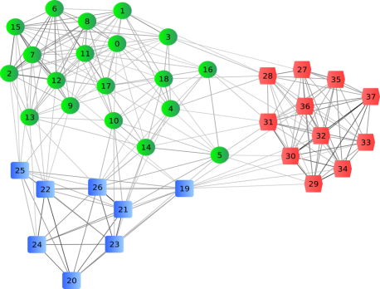
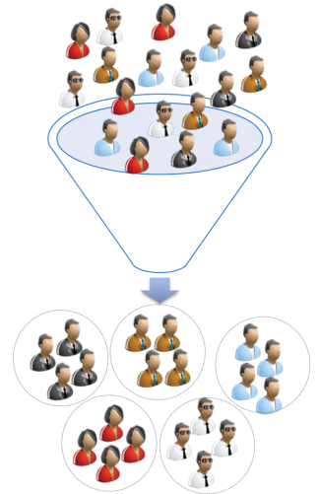


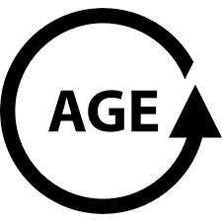





Clustering – Patterns to identify customers to conduct pilot tests
Understand key characteristics of the customer segments using Clustering approach
Data Collection
Identify Characteristics of each cluster
Sample Cluster
Characteristics
Clustering
Transaction Data across each category
A
B
C
Segment A – Loyalty customers with high propensity to buy
Segment B – Festive shoppers with high festive season spends
Segment C – Periodic Repeat customers via online channel
Segment D – Customers who buy in specific outlets
Segment E – Customers who buys fitness products
D
E
Customer
Demographics data
Store
Demographics data

Slide 12





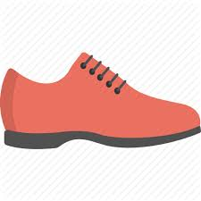
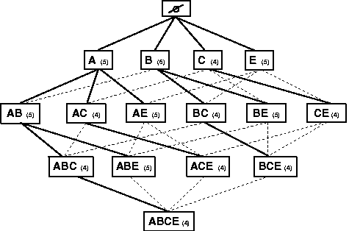
Deliverable 1: Drive Customer Propensity to buy providing right product recommendations
Assume segment X (London Fashion Divas), which contains female Harrod’s loyalty Customers buying leather coat & jeans.
Based on purchase patterns of customers in this segment, a marketing push to cross sell beanie hats is recommended
SEGMENT X (LONDON FASHION DIVAS)
TARGET Customer A -- Buys Leather Coat & Jeans
Transactions in a
Segment
Items in basket
T1
Antecedent
Consequent
Rule 1:
Top Recommendation
T2
Rule 2:
T3
Rule 3:
T4
Use Apriori algorithm to generate set of products that are bought together
Top recommendations generated using Support, Confidence & Lift
T5
Market Basket Analysis performed for all products bought by Customers in a segment.
Select the product with highest likelihood to co-occur in the basket

Slide 13




Illustration: Product Recommendation across Customer segments
Assuming 4 Customer Segments, different products can be recommended to each of the Customers within these segments based on various factors such as Purchase pattern, Loyalty etc
London Trekkers
London Fashion Divas
New Moms
High interests in Adventure & Fitness
High interests in Fashion & Style
Items Bought Frequently :
Shoes
Bag
Items Recommended :
Tent
Tools
Items Bought Frequently :
Chloe Belted Coat
Burberry Scarf
Gucci Shoulder Bag
Gucci Belted Skirt
Items Recommended :
Jeans
Boots
High interests in Baby Products & Fitness
Items Bought Frequently :
Cybex Stroller
Sleeping Bag
Car Seat
Outdoor Equipment
Items Recommended :
Crib
Car
Yoga Mat
Faithful Fiestas
High interests in Festivals & Celebrations & Loyalty Member
Items Bought Frequently :
Champagne
Christmas Trees
Items Recommended :
Chocolate Hampers
Glassware

Slide 14



Deliverable 2: Projected Trade for HNW Customers using CLV modeling
Machine Learning based CLV models leverage and learn from customer data – their preferences, buying behavior etc. and predict with better precision compared with traditional CLV methods
Model Steps
Churn Prediction
Sales Forecasting
CLV Calculation
Model Description
Churn classification model using ML supervised algorithm such as Logistic Regression
Sales forecasting model based on historical data using ML supervised algorithm such as Linear Regression
Combining the results of previous two models and leveraging other important features to arrive at CLV metric
Illustrative Features Used
Demographic data, Geographic data, Psychographics data
Sales & Transactional data: Recency, Frequency, Monetary features
Outcome of two models and other attributes such as Profit Margin, Customer lifespan
Formulae
CLV = Function (Churn Prediction, Sales Forecasting, Profit Margin, Customer Lifespan)
Customer ID | Churn Propensity | Sales Forecast (‘000 $) | Profit Margin | Potential CLV (‘000 $) | Realized CLV (‘000 $) | Pending CLV (‘000 $) | CLV Category | Churn Classification
C1 | 48% | $41,16 | 10.45% | $224 | $89 | $134 | Medium | Moderate
C2 | 80% | $15,70 | 15.76% | $49 | $20 | $30 | Low | High
C3 | 41% | $26,04 | 29.40% | $452 | $181 | $271 | High | Moderate
C4 | 35% | $35,70 | 6.30% | $146 | $58 | $88 | Medium | Moderate
C5 | 46% | $22,18 | 12.65% | $152 | $61 | $91 | Medium | Moderate
C6 | 12% | $19,70 | 18.50% | $321 | $128 | $192 | High | Low
ILLUSTRATIVE

Slide 15







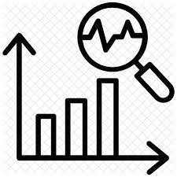

Phase 2: Enhance Product recommendations using internal & external data
The modeling output can be further improved by enhancing the quality of data fed into the algorithm.
Phase 1: Leverage Internal Data
Phase 2: Augment with External Data
Phase 1
Phase 2
Leverage internal data
Augment with External data
ML / AI Services & Visualization
Transactional Information
Partner Ecosystems (Credit Card, Brand, Real Estate)
Web Sessions
Demographic ,Economic ,Census Information
Marketing Campaign data
Seasonality, Social Media
Agent Feedback Score(In store)
Improved Cohort Performance
Determine Customer LifeTime Value
Improved Modelling Accuracy
Improved Customer Reach/Targeting

Slide 16
Potential External Data Sources
LatentView proposes to integrate a wide range of variables from variety of data sources listed below. These are indicative & prioritized in collaboration with Harrod’s in the initial 2 weeks (discovery phase) based on Feasibility, Applicability, Complexity & Cost.
Harrod ’s Internal Data
Transactional:
- Sales information at channel, location, SKU granularity (daily, weekly, monthly timeframes)
- Product assortment
Web sessions:
- Web analytics – Visits, Sessions, Pages viewed etc.
- Website engagement information
- Panel data (if any)
Marketing Campaigns:
- Marketing campaigns / efforts (Instore, online)
- Promotions, offers, discounts, returns , seasonality
Agent Feedback (Store level):
- Agent feedback in store at a customer / product(if any)
- Product assortment feedback from agents
Syndicated Data
Partner Ecosystems:
- Credit card partnerships – Share of wallet
- Purchasing power (Transactional)
- Competitor purchase info (Transactional)
- Real estate / Property Data – Ex: Black Knight (US)
- Housing units, Household size, type
- Brand Partnership – Procured from partner brands
Demographics:
- Nielsen / Acxiom – Customer Behaviour
- Population, Median Age
- Race distribution, Gender, Median wage etc.
- Psychographic data
Seasonality Data – Weather:
- Temperature, Wind, Humidity, Precipitation, Cloud, Frost/dew/snow indicators
External Data
Economic Indicators:
- UK Data Service, World Bank etc
- Macro Indicators – House prices, Oil prices etc.
- # Business Establishments
- Sales, Annual Payroll, # Employees on payroll
- Stock indices
Census Data – Zip / Pin Code:
- Census bureau, - # Population, Age, Distribution
- #Households, # Average Households Size
Social Media:
- Customer’s social profiles, handles, activity
- # Brand mentions
Location (GIS) Data:
- Customer neighborhood, #Events in Neighborhood

Slide 17
Illustrations: Enhance Recommendations
Augmenting data quality with external inputs will enhance recommendations provided by the model across categories & brands.
An illustration can be seen below.
Internal Data
Transactions in a
Segment
Items in basket
Top Recommendation
Antecedent
Consequent
T1
C1
Rule 1:
Prada, Gucci
Illustration : Augment with Partner Data (Credit Card Spends)
Credit Card Transactions for Customer C1
Top Recommendation
New
Recommendation
 | $ Spent | Brands Purchased | Discount offered
Harrods | 10k | Prada, Gucci | 5%
Farfetch | 25k | Prada, Gucci | 30%
Antecedent
Consequent
Rule 1:
20% discount
Prada, Gucci

Slide 18





Step 3: Evaluate performance using A/B testing
Model performance can be evaluated using A/B tests on product categories, stores / segments for the business to do live tests & see if each event does lead to higher trade in that segment (or) with that Customer.
Marketing
Share data with store executives
Campaign Planning
Experiment Design
Target Identification
Execution
Track Measurement
Budget and Target Revenue
Schedule of Campaigns
Store identification
Segment identification
Category identification
Frequency & duration
Channel(s) of contact
Eligible population
Offers / promotions
Target User selection
Control user selection
Target customers through chosen channel
Record offer and response data
Analyze campaign response rates and sales volume
Refine Models based on Performance
Assess Model Performance through statistical testing
# Sales
Pre-Campaign
Post Campaign
Incremental Lift
[ B/Y] / [A/X] - 1
Target
A
B
Incremental lift is calculated by comparing the ratio of Target : Control across the post campaign over pre campaign periods
Control
X
Y
Significance Testing
Equivalence Testing
In Significance Testing, i.e. Hypothesis Testing, we try to develop an idea of our own or confront previously held beliefs about whether launched campaign was/was not significant to the output of the process.
Equivalence tests assess whether there is a practical difference in means of Target and Control Group post-campaign.

Slide 19
Representative Case Studies

Slide 20

Identifying Potential Annual Members using Segmentation
Leading Home Appliances and Repair Services Provider
The Problem: Our client did not have a scientific way to target the trial members who have the characteristics of becoming the annual members
Business Objective
LatentView Solution
Business Benefits
To identify the trial members who have the more likelihood of taking the Annual Membership
Understanding the transaction behaviour of Annual Members who were trial before taking up Annual Membership
Segmentation of Trial and Annual Members on the basis of Transaction Behaviour
Applying the Business Rules (e.g VIP, Savings amount and Recent order) and targeting with appropriate messaging
Segmentation of members leading to reduction of target trial members (55 K to 3 K)
A better targeting strategy with reduction in Annual Membership price from $39 to $19
Segmentation
Identify the Characteristics of each cluster
Apply the Characteristics
on the trial members
Target Population
Business rules
Notes:
Sears

Slide 21
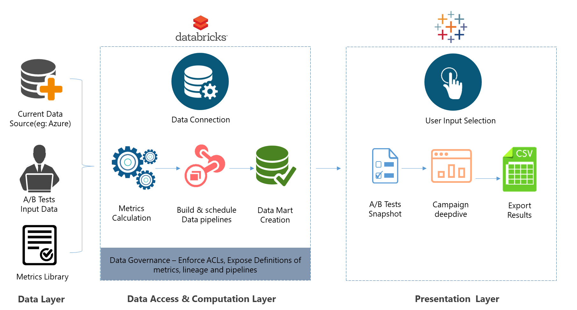
Improving Customer Experience using Site Analytics
Leading American E-Commerce Retailer
The Problem: Lack of a comprehensive measurement platform of site-wide A/B testing activities led to time consuming and manual efforts involved in tracking & improving customer experience
The “Before” State
LatentView Solution
The “After” State
Client ran multiple A/B testing methods to determine the product positioning, placement, messaging, color of various web elements.
There was no single platform to keep a tab on all the experiments. As a result, each business unit had their own resources to track their testing measurements.
Built a one stop visualization platform to track and measure the site-wide A/B testing experiments using Tableau.
Derived useful business metrics such as Lift %, Lift Trends calculation across all the dimensions such as OS, Browser, Marketing channels etc.
Centralized all A/B testing experiments at scale and reduced manual tracking efforts.
Applied Bayesian approach to call out early variant winners with 60% improvement.
Deployed the A/B testing measurement platform to the executive team to classify the experiments as positive, neutral and negative.
Methodology
Notes:
Sam’s Club

Slide 22
Maximize Business Value using Optimization and Personalization
US Based Retail Corporation
The Problem: Identify the right communication to be placed at the right slot on the right channel for a given customer/customer
segment that maximizes both the marketing and merchandising goals
Offers on the web page and email based on ad-hoc customer segmentation and random placement of the same on the web-page/email.
LatentView Solution
The “Before” State
Challenges
Millions of customers across segments
100s of webpages & 100s of Email Layouts
1.7M+ SKUs with 1K+ Offers every week
Each BU with different objective to maximize
Experimentation set up not consistent with the goal
Identify key-metric by BU to maximize by customer segment
Unified segmentation logic that is consistent across Bus
Optimization algorithm that recommends the right offer by slots factoring in the business rules to maximize the chosen metric by BU
Continuous experimentation to evaluate the efficacy and improve from feedback
Estimate
Optimize
Choose the top offers with the highest:
Propensity to click
Purchase conversion
Value generated
Display offers to:
Maximize propensity to click/convert by customer
Based on Page / email composition constraints
Business rules
Experiment
DYNAMIC PERSONALIZED
Universal set of marketing
and merchandising offers
Test new offers, creatives, layouts
Evaluate impact of optimization
Analyze and refine
OFFERS
Notes:
Map need sto be clear

Slide 23




Evaluate performance using A/B testing
50+A/B Testing
Experts
15+ A/B Testing
Projects
Across 5 Industries
1500+
Person Hours
Client
Business Objective
Platform/Technology Used
LatentView's Involvement
Largest Payment gateway
Improve Customer and Merchant account acquisitions and engagement on the website
PXP/ELMO
Tealeaf
Involved in end to end experimentation life cycle management involving ideation, design, execution, analytics and feedback for future experiments.
To optimize the web page design by understanding user behavior patterns in order to improve user engagement
Google Analytics
Spotfire
Google BigQuery
Started in 2013. Since then Latentview is continuously provided support by giving insights on the A/B testing using an analytical approach
Leading Airlines company
Leading baby food nutirition company
To decrease enrolment form drop-off by experimenting with the number of fields on the registration form.
Google Analytics
Optimizely
Generated insights on both the original and variant designs. The experiment outcome led to a higher conversion rate for the business.

Slide 24
Thank You

